Slide 1
Angle between the Chords
From a puzzle by Catriona Shearer

Slide 2


Angle between the Chords
Two chords touch each other and the rectangle.
Two radii lengths are shown.
What is the value of the angle between the chords?
$$5$$
$$2$$
(Not drawn to scale)

Slide 3












Angle between the Chords
$$45°−\frac{θ}{2}$$
$$θ$$
$$45°−\frac{θ}{2}$$
$$90°−θ$$
$$\frac{θ}{2}$$
$$θ$$
$$θ$$
$$5$$
$$2$$
$$a$$
$$a$$
$$2a$$

Slide 4



Angle between the Chords
$$45°−\frac{θ}{2}$$
$$135°$$
$$\frac{θ}{2}$$

Slide 5
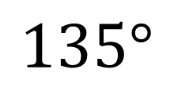
Angle between the Chords
Two chords touch each other and the rectangle.
Two radii lengths are shown.
What is the value of the angle between the chords?
$$5$$
$$2$$
$$135°$$
(Not drawn to scale)
And the lengths of the radii are irrelevant!

Slide 6











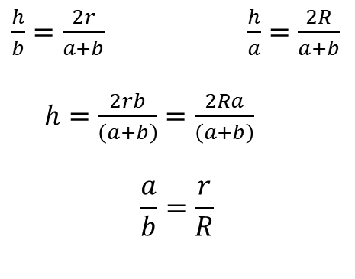

Angle between the Chords
There is another way …
$\frac{h}{b}=\frac{2r}{a+b}$ $\frac{h}{a}=\frac{2R}{a+b}$
$h=\frac{2rb}{\left(a+b\right)}=\frac{2Ra}{\left(a+b\right)}$
$$\frac{a}{b}=\frac{r}{R}$$
$$R$$
.
$$r$$
$$135°$$
$$R$$
$$r$$
$$R$$
.
$$r$$
$$45°$$
$$r$$
$$h$$
$$a$$
$$b$$

Slide 7
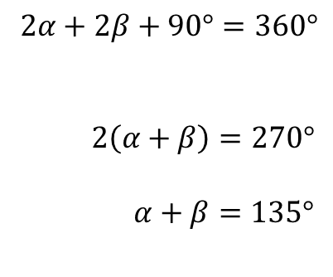





Angle between the Chords
And another …
$$α$$
$2α+2β+90°=360°$
$2\left(α+β\right)=270°$
$α+β=135°$
(Angle sum in a quadrilateral is $360°$)
$$α$$
$$β$$
$$β$$
$$5$$
$$2$$
Common tangent

Slide 9






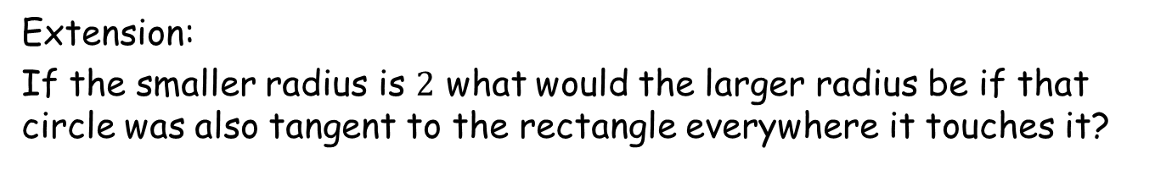


Extension:
If the smaller radius is $2$ what would the larger radius be if that circle was also tangent to the rectangle everywhere it touches it?
$\sqrt{2}R=R+2+2\sqrt{2}$
$\left(\sqrt{2}−1\right)R=2\left(\sqrt{2}+1\right)$
$R=\frac{2\left(\sqrt{2}+1\right)}{\left(\sqrt{2}−1\right)}$
$R=2{\left(\sqrt{2}+1\right)}^{2}$
$R=6+4\sqrt{2}$
$$R$$
$$R$$
$$R$$
$$2$$
$$2$$
$$\sqrt{2}$$
$$2$$

Slide 11

Note to Teacher
The required angle ($135°$) is invariant.
The Geogebra file demonstrates this.

Slide 12
RESOURCES

Slide 13
Angle between the Chords
Two chords touch each other and the rectangle.
Two radii lengths are shown.
What is the value of the angle between the chords?
$$5$$
$$2$$
A
(Not drawn to scale)
SIC_80

Slide 14


Angle between the Chords
Two chords touch each other and the rectangle.
Two radii lengths are shown.
What is the value of the angle between the chords?
$$6$$
$$3$$
B
(Not drawn to scale)
SIC_80

Slide 15

Angle between the Chords
Two chords touch each other and the rectangle.
Two radii lengths are shown.
What is the value of the angle between the chords?
$$6$$
$$4$$
C
(Not drawn to scale)
SIC_80

Slide 16

Angle between the Chords
Two chords touch each other and the rectangle.
Two radii lengths are shown.
What is the value of the angle between the chords?
$$7$$
$$4$$
D
(Not drawn to scale)
SIC_80

Slide 17

Angle between the Chords
Two chords touch each other and the rectangle.
Two radii lengths are shown.
What is the value of the angle between the chords?
$$7$$
$$5$$
E
(Not drawn to scale)
SIC_80

Slide 18

Angle between the Chords
Two chords touch each other and the rectangle.
Two radii lengths are shown.
What is the value of the angle between the chords?
$$8$$
$$5$$
F
(Not drawn to scale)
SIC_80

Slide 19

Angle between the Chords
Two chords touch each other and the rectangle.
Two radii lengths are shown.
What is the value of the angle between the chords?
$$8$$
$$6$$
G
(Not drawn to scale)
SIC_80

Slide 20

Angle between the Chords
Two chords touch each other and the rectangle.
Two radii lengths are shown.
What is the value of the angle between the chords?
$$9$$
$$6$$
H
(Not drawn to scale)
SIC_80

Slide 21

Angle between the Chords
Two chords touch each other and the rectangle.
Two radii lengths are shown.
What is the value of the angle between the chords?
$$9$$
$$7$$
I
(Not drawn to scale)
SIC_80

Slide 22

Angle between the Chords
Two chords touch each other and the rectangle.
Two radii lengths are shown.
What is the value of the angle between the chords?
$$10$$
$$7$$
J
(Not drawn to scale)
SIC_80

Slide 23

Angle between the Chords
Two chords touch each other and the rectangle.
Two radii lengths are shown.
What is the value of the angle between the chords?
$$10$$
$$8$$
K
(Not drawn to scale)
SIC_80

Slide 24

Angle between the Chords
Two chords touch each other and the rectangle.
Two radii lengths are shown.
What is the value of the angle between the chords?
$$11$$
$$8$$
L
(Not drawn to scale)
SIC_80

Slide 25
Angle between the Chords
Two chords touch each other and the rectangle.
Two radii lengths are shown.
What is the value of the angle between the chords?
$$11$$
$$4$$
M
(Not drawn to scale)
SIC_80

Slide 26
Angle between the Chords
Two chords touch each other and the rectangle.
Two radii lengths are shown.
What is the value of the angle between the chords?
$$11$$
$$5$$
N
(Not drawn to scale)
SIC_80

Slide 27
Angle between the Chords
Two chords touch each other and the rectangle.
Two radii lengths are shown.
What is the value of the angle between the chords?
$$11$$
$$6$$
O
(Not drawn to scale)
SIC_80

Slide 28
Angle between the Chords
Two chords touch each other and the rectangle.
Two radii lengths are shown.
What is the value of the angle between the chords?
$$11$$
$$7$$
P
(Not drawn to scale)
SIC_80

Slide 29

Angle between the Chords
Two chords touch each other and the rectangle.
Two radii lengths are shown.
What is the value of the angle between the chords?
$$12$$
$$7$$
Q
(Not drawn to scale)
SIC_80

Slide 30
Angle between the Chords
Two chords touch each other and the rectangle.
Two radii lengths are shown.
What is the value of the angle between the chords?
$$12$$
$$8$$
R
(Not drawn to scale)
SIC_80

Slide 31

Angle between the Chords
Two chords touch each other and the rectangle.
Two radii lengths are shown.
What is the value of the angle between the chords?
$$12$$
$$9$$
S
(Not drawn to scale)
SIC_80

Slide 32

Angle between the Chords
Two chords touch each other and the rectangle.
Two radii lengths are shown.
What is the value of the angle between the chords?
$$13$$
$$9$$
T
(Not drawn to scale)
SIC_80

Slide 33

Angle between the Chords
Two chords touch each other and the rectangle.
Two radii lengths are shown.
What is the value of the angle between the chords?
$$13$$
$$10$$
U
(Not drawn to scale)
SIC_80

Slide 34

Angle between the Chords
Two chords touch each other and the rectangle.
Two radii lengths are shown.
What is the value of the angle between the chords?
$$14$$
$$10$$
V
(Not drawn to scale)
SIC_80

Slide 35

Angle between the Chords
Two chords touch each other and the rectangle.
Two radii lengths are shown.
What is the value of the angle between the chords?
$$15$$
$$10$$
W
(Not drawn to scale)
SIC_80

Slide 36

Angle between the Chords
Two chords touch each other and the rectangle.
Two radii lengths are shown.
What is the value of the angle between the chords?
$$15$$
$$11$$
X
(Not drawn to scale)
SIC_80

